Slide 1
Compressed Sensing MRI
Drew McCallister

Slide 2
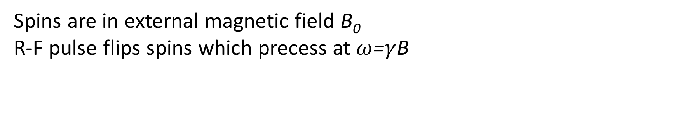
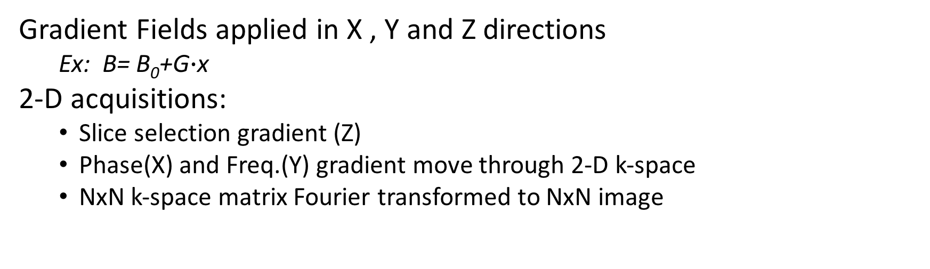
How MRI works
B₀
R-F
Spins are in external magnetic field B₀
R-F pulse flips spins which precess at $ω$=$γ$B
Illustration of z-gradient
Gradient Fields applied in X , Y and Z directions
Ex: B= B₀+G$∙$x
2-D acquisitions:
Slice selection gradient (Z)
Phase(X) and Freq.(Y) gradient move through 2-D k-space
NxN k-space matrix Fourier transformed to NxN image

Slide 3
The Problem
Larger Gradients -> Higher Freq. in K-space -> Higher Resolution
Theoretically MRI resolution is dependent on Gradient Strength
In practice we image living things
->Practically, scan time limits resolution
Fourier Transform

Slide 4
How do we reduce K-space points but not resolution?
What prior knowledge do we have about MRI k-space?
Symmetrical
Partial Fourier reconstruction
Projection Onto Convex Sets (POCS)
Compressible
Under wavelet or other transform, MRI images are sparse
Histogram of Pixel Magnitude
Insignificant
Significant
Discrete Wavelet Transform
It would be great if we could acquire in DWT space and only acquire the interesting points
……. But we can’t

Slide 5
Compressed Sensing
=
If we know X is sparse,
can we invert Φ to get X from Y?
Φ
X
Y
Theorem: If Φ satisfies Restricted Isometry Property (RIP), then x is unique, sparse solution to Φx=y
Meaning: If Φ is nearly an orthogonal matrix,
we can recover x by solving:
min|x|₀ such that Φx=y
L_{p} norms: |x|_{p}=(Ʃ|x|^{p})^{1/p} where |x|₀ is the number of non-zero entries

Slide 6
Application to MRI
Minimizing the L₀ norm is computationally very expensive
L₁ norm is convex and much simpler to minimize
->Theorem: L₁ min = L₀ min if Φ satisfies RIP to a more stringent limit
Applying to MRI:
Fourier transforming k-space “f” to get image “u” that we sparsify with wavelet transform “W” and minimize
min|Wu|₀= such that Fu=f
In practice due to noise we don’t enforce Fu=f
min|Wu|₀= such that |Fu-f|₂<σ

Slide 7
Minimization
Compressed Sensing Test Sparsity = 25%
Original Image
Under-sampled k-space
If we randomly under sample our k-space, satisfies RIP
Split-Bregman Method
Modified Bregman-Iteration method
commonly used for L₁ minimization
Used Haar wavelet for DWT
Under-sampled image
Recovered Image

Slide 8
Brain image with Sparsity = 50%
Original Image
Under-sampled k-space
Under-sampled Image
Recovered Image

Slide 9
Future Directions
Minimization performance depends on a length-scale gamma
-Characterize parameter space for relevant image types
Implement compressed sensing for 3-D k-space images

Slide 10
Compressed Sensing
Allows for recovery of data that is sparse in a wavelet basis from a randomly under-sampled “sensing” measurement basis
Applications far beyond MRI
Sensor Networks and data acquisition
Reduction of power consumption and reduced sensor processing
Astronomy
Reconstruction of signal from incomplete and noisy data
Linear coding
Reconstruction of corrupted transmissions
Good short intro for those interested:
Terrence Tao’s blog on single pixel cameras

